Slide 1
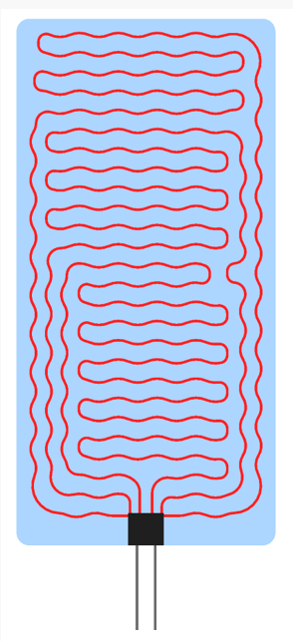
Product Data Sheet
Product Description
PET
Printed heater
Features and Benefits
a degree of thermal uniformity
a thin thickness
flexibility
Key Applications
- Defrosting Heater

Slide 2
Product Data Sheet
1CA6A6NNXA0021 / FE0000A3
Table of Contents
Index | page
Product Brief | 1
Table of Contents | 2
Performance Characteristics | 3
Characteristic Diagram | 4
Reliability Test | 5
Mechanical Dimensions | 6
Product Nomenclature | 7
Packaging | 8
Precaution For Use | 9

Slide 3
Product Data Sheet
1CA6A6NNXA0021 / FE0000A3
Performance Characteristic
Category | standard | Tolerance | Remarks
product name | FE0000A3
P/N | 1CA6A6NNXA0021
Substrate | PET, 0.25T | ±0.1mm
Size | 200mm X 406mm | ±2mm
Weight | 25.37g | ±%
Rated voltage | 24DCV | -
Resistance | 21Ω | ±10%
Electricity | 27W | ±10%
Power density | 0.35W/cm2 | ±10%
Insulation resistance | DC500V, 5sec | < 100MΩ
Withstand voltage | AC1800V, 5sec | < 10mA
Temperature of use | < 80℃
* Resistance is a measurement tolerance
* conditions of single product condition
* Temperature of use is Single Product Operating Environment
Absolute Maximum Rating
구분 | Voltage used | Heater temperature | Operating conditions
Single Product Operating Environment | ~24V | 50℃ | at 25℃
Maximum Operating Environment | ~.30V | 80℃ | at 25℃
* Product is not guaranteed for operations above the above conditions

Slide 4
Product Data Sheet
1CA6A6NNXA0021 / FE0000A3
Characteristic Diagram
Test method : 25℃, 1 Measurement of saturation temperature at voltage rise
Test method : 25℃, 1 Power consumption at voltage rise

Slide 5
Product Data Sheet
1CA6A6NNXA0021 / FE0000A3
Reliability Test
※ Judgement is resistance change before and after
item | Test Condition | Duration / Cycle | Number of Damage | Judgment
High temperature | Storage at 90℃ | 94hr | 0/3 | <10%
Low temperature | Storage at - 40℃ | 94hr | 0/3 | <10%
High temperature and humidity | Storage at 85℃, 85% | 94hr | 0/3 | <10%
Thermal shock | Repeat storage at 80℃(2hr) and -40℃(2hr) | 100hr | 0/3 | <10%
Continuous operation | Apply 120% of rated voltage at R.T | 96hr | 0/3 | <10%
On/OFF operation | Apply 120% of rated voltage and repeat 1 minute of operation and 1minute of rest | 10,000 cycle | 0/3 | <10%

Slide 6
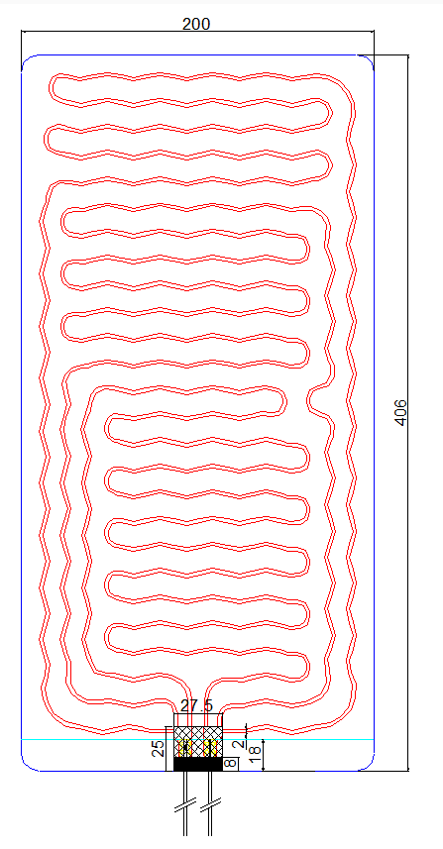
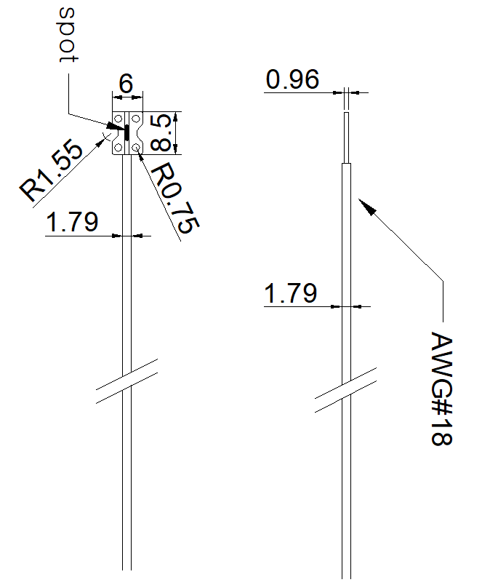
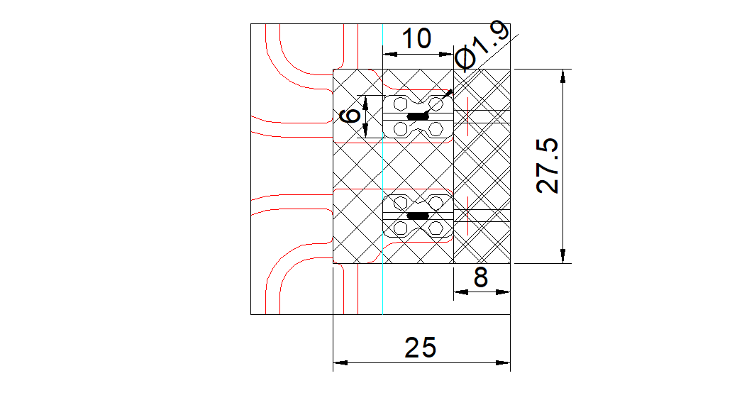
Product Data Sheet
1CA6A6NNXA0021 / FE0000A3
Mechanical Dimensions
Notes : All dimensions are in mm

Slide 7
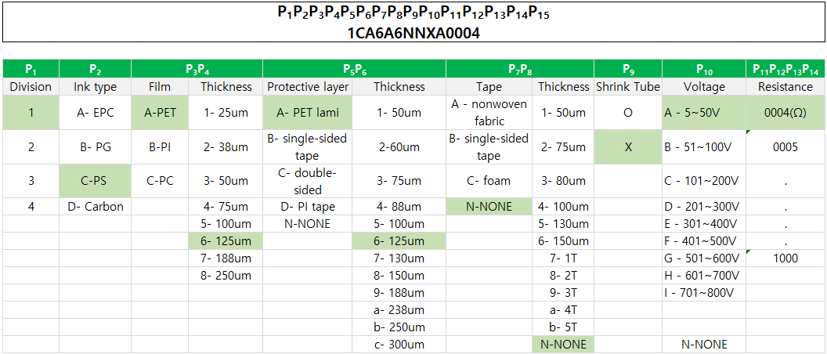
Product Data Sheet
1CA6A6NNXA0021 / FE0000A3
Product Nomenclature
① Part Numbering System
② Serial Numbering System

Slide 8
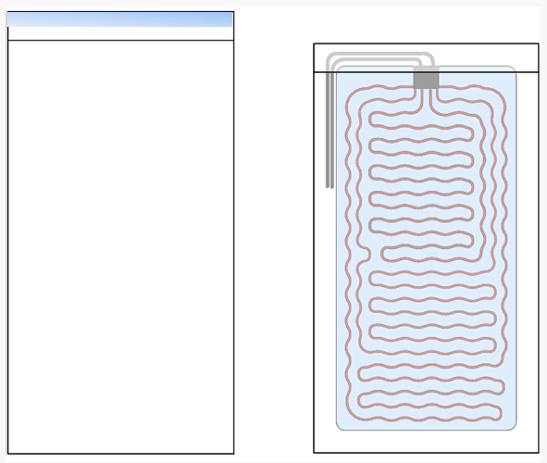
Product Data Sheet
1CA6A6NNXA0004 / FE0000A3
Packaging
Product Package box
OPP Bag
Quantities of 10 or less are shipped in OPP gabs
Outer Cartoon Box
For quantities of 10 or more, pack 10 each in an opp bag and ship in a box.

Slide 9
Product Data Sheet
1CA6A6NNXA0021 / FE0000A3
Precaution for Use
Scratches on the surface may cause malfunction
If the film is folded, it may cause the heater to malfunction
There should be no contaminants on the surface when the heater heats up
Avoid being around materials vulnerable to heat
Do not use the product in water
Do not disassemble and use
Be careful of external shocks during assembly and delivery.
Immunity
∙ The descriptions and technical data presented in this document have been prepared in accordance with generally accepted procedures.
This document was created using our own testing equipment and technology
We are not responsible if operated without complying with the specifications written in the specifications.

